Slide 1

DECISION TREE LEARNING
AND REPRESENTATION
CO1 AT3
ITA0611 - MACHINE LEARNING
by,
Fathi Muthu Johara M (192411009)
Faculty,
Dr.Sivakumar K

Slide 2
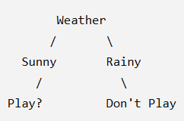
WHAT IS A DECISION TREE?
  A decision tree is a tree-based model used for making decisions.
  It represents knowledge in the form of a tree.
It contains:
  Root node – starting point
  Decision nodes – conditions or questions
  Branches – possible outcomes
  Leaf nodes – final result/class

Slide 3
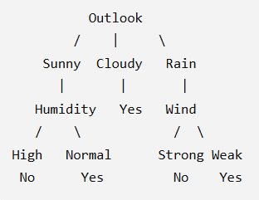
WORKING OF DECISION TREE
  Start with the complete training dataset.
  Select the best feature for splitting.
  Divide the dataset based on that feature.
  Repeat the process for each branch.
  Stop when a suitable stopping condition is reached.
  The final nodes give the prediction.

Slide 4
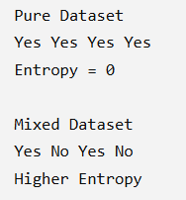
ENTROPY
  Entropy measures the impurity or uncertainty in a dataset.
  Lower entropy means the data is more pure.
  Higher entropy means the data is more mixed.
Formula
Entropy(S) = −Σ pᵢ log₂(pᵢ)
Where:
  S = dataset
  pᵢ = probability of each class

Slide 5
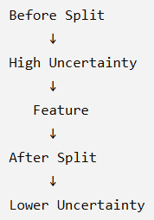
INFORMATION GAIN
  Information Gain helps us choose the best feature for splitting.
  It measures how much uncertainty is reduced after a split.
  The feature with higher information gain is preferred.
Formula
Information Gain = Entropy before splitting − Weighted Entropy after splitting

Slide 6
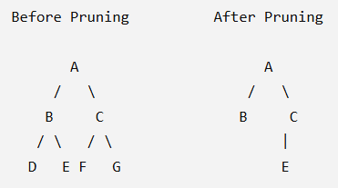
TREE PRUNING
  A very large decision tree may overfit the training data.
  Pruning removes unnecessary branches.
It makes the tree:
  Smaller
  Simpler
  Easier to understand
  Less likely to overfit

Slide 7
CONCLUSION
  Decision trees represent knowledge using a tree structure.
  Entropy measures uncertainty.
  Information Gain helps select the best feature.
  Pruning reduces overfitting.
  Decision trees are useful for classification and decision-making.

